Slide 1
Lecture 13 LAN TECHNOLOGIES AND NETWORK TOPOLOGIES
LAN - computer network that interconnects computers in a limited geographical area such as a school, campus, computer laboratory, single building and others.
LANs:
Are private owned
Do not use leased telecommunication lines
Distance is limited to a kilometre
Ethernet over twisted pair cabling and Wi-Fi are the two most common technologies currently used to build LANs.

Slide 2
Early
Early LANs used dedicated links between each pair of computers.
These would form a mesh or point to point connection.
Advantages of dedicated links were:
Allowed flexibility in communication hardware and packet formats (could be tailored)
Provided security and privacy because communication channel was not shared.
Flexibility in communication hardware and packets formats was achieved because hardware and frame detail could be tailored for each link.

Slide 3
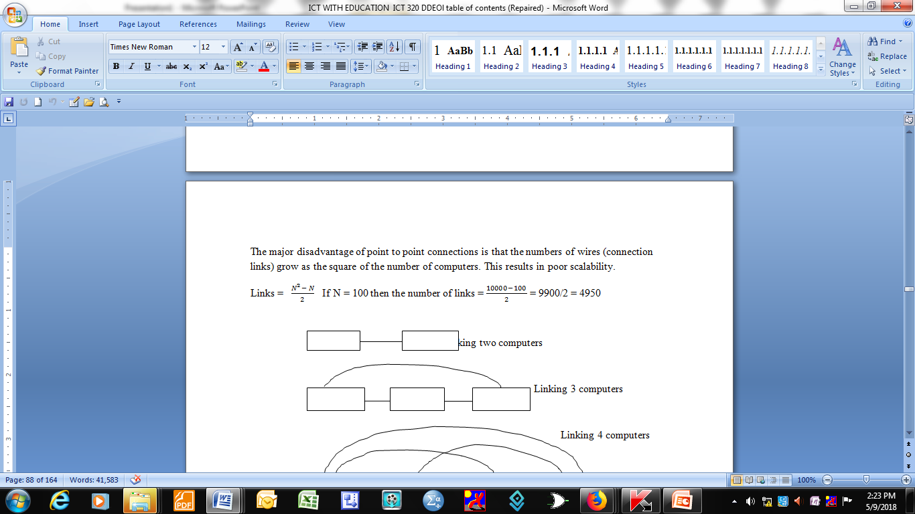
Disadvantages
The major disadvantage of point to point connections is that the numbers of wires (connection links) grow as the square of the number of computers. This results in poor scalability.

Slide 4
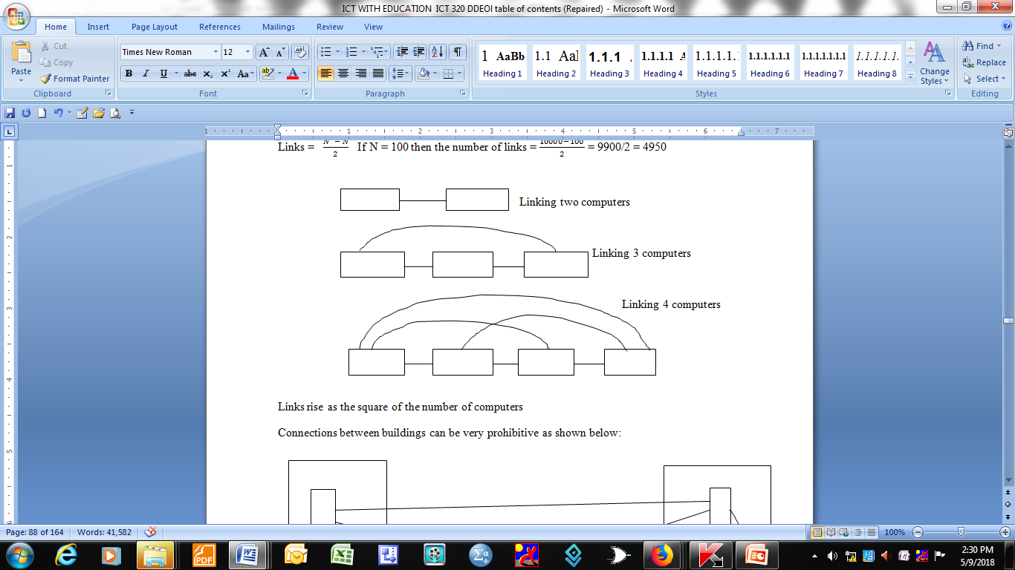
Dedicated links

Slide 5
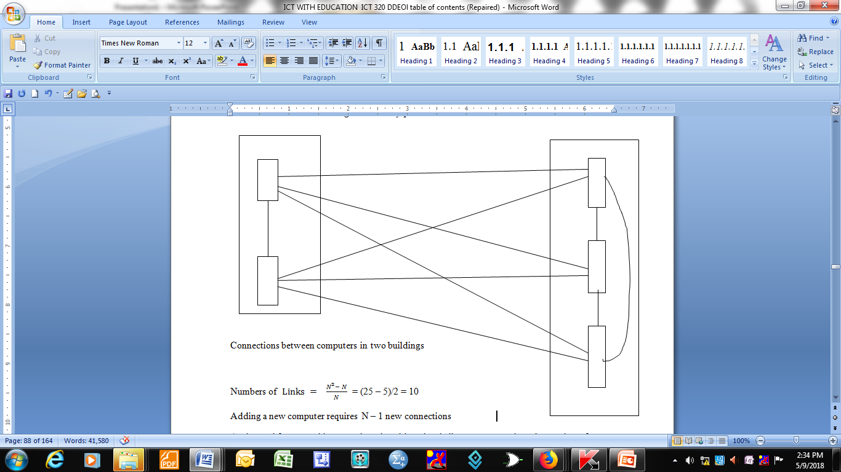

Slide 6
Rise in demand for networking
As demand for networking grew in universities, the challenge was to reduce the number of communication channels so as to reduce costs and at the same time improve on channel capacity utilization. Key idea was to reduce the number of connections by sharing connections among many computers. There also arose the need to coordinate computer access to shared media.

Slide 7
Multiplexing technique
Time division multiplexing was the prominent technique used to share communication media and it also includes techniques of synchronizing communication channel use.

Slide 8
Locality of reference
LANs these days connect more computers than any other form of network.
The reason for their popularity is due to the principle of locality of reference. This principle helps to predict computer communication patterns.

Slide 9
Locality of reference manifestation
Locality of reference principle manifests itself as:
Spatial (or physical) locality of reference which states that computers are likely to communicate with other computers that are located nearby
Temporal locality of reference which states that computers are likely to communicate with the same computers repeatedly
These two give an insight into which computers should be on a LAN.

Slide 10
LAN Topologies
LANs can be organized into various different structures called topologies. These structures can be:
Physical topologies – which show how wires are organized in a LAN
Logical topologies – show how a network behaves logically
Three primary physical topologies are:
Bus
Star
Ring

Slide 11
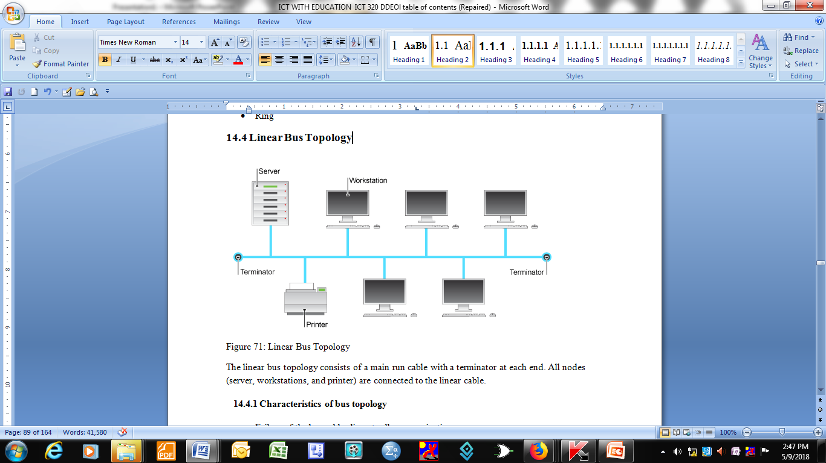
Linear Bus Topology

Slide 12
Linear bus topology components
The linear bus topology consists of a main run cable with a terminator at each end.
All nodes (server, workstations, and printer) are connected to the linear cable.

Slide 13
Characteristics of bus topology
Failure of the bus cable disrupts all communication
Failure of devices does not affect entire network
There is a limit on the length of the network (devices do not amplify/repeat the signal)
Propagation delay is not affected by the number of devices that are attached to the cable

Slide 14
Advantages & disadvantages
Advantages of linear bus
Easy to connect a computer or peripheral device once cable is laid down
Require less cable length than a star topology
Disadvantages
Entire network shuts down if there is a break in the main cable
Terminators are required at both ends
Difficult to identify a problem if the entire network shuts down

Slide 15
Star Topology
In this topology all nodes are connected directly to a central network hub, switch or concentrator.
Data passes through the hub before continuing to its destination. The hub, switch or concentrator manages and controls all functions of the network.
It also acts as a repeater for the data flow.

Slide 16
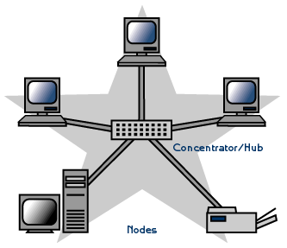
Star topology diagram

Slide 17
Advantages & Disadvantages
The above configuration is common with twisted pair cables.
Advantages
Easy to install and wire
No disruptions to the network when connecting or removing devices
East to detect faults and remove parts
Disadvantages
Requires more cable length compared to linear bus
If hub/switch/concentrator fails, nodes attached are all disabled
More expensive compared to linear bus topologies because of the cost of hubs/concentrators/switches.

Slide 18
Tree or expanded star topology
The tree topology combines the characteristics of a linear bus and star topologies.
Star configured workstations are connected to a linear bus backbone cable.
Tree topologies allow the expansion of an existing network and allow schools to configure a network to meet their needs.

Slide 19
Advantages& Disadvantages
Advantages
Point to point wiring of individual segments
Supported by several hardware and software vendors
Disadvantages
Overall length of each segment is limited by the type of cabling used
If the backbone cable breaks down, the entire segment goes down
More difficult to configure and wire than other topologies

Slide 20
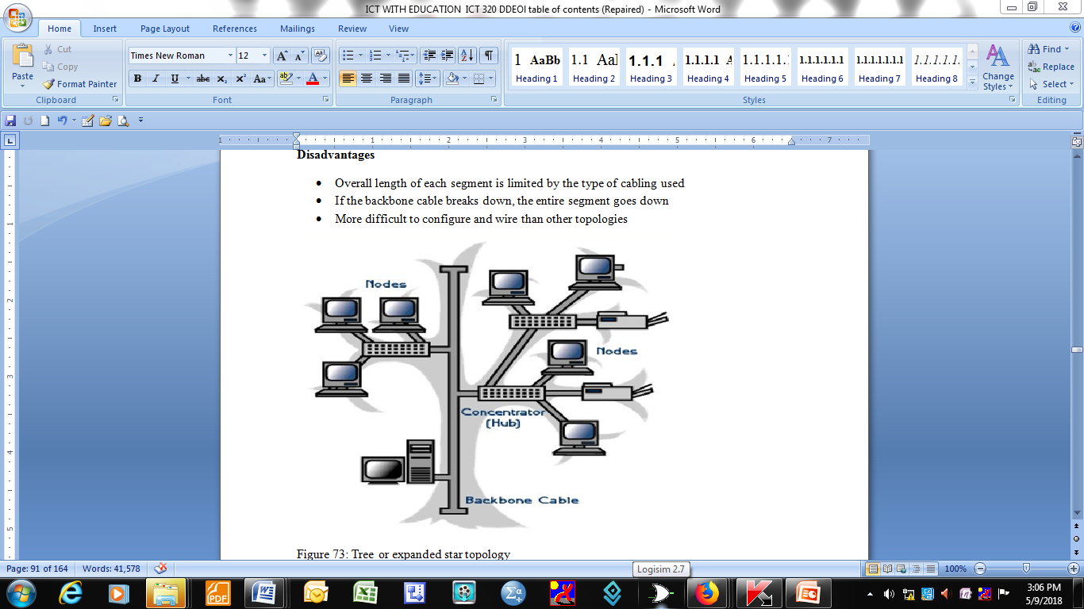
Tree topology structure

Slide 21
The 5-4-3 Rule
This rule is used when setting up a tree topology using Ethernet protocol.
One aspect of the Ethernet protocol requires that a signal sent out on the network cable reach every part of the network within specified length of time.
From each concentrator/repeater a signal goes through adds a small amount of time.
This leads to the rule that between any two nodes on the network there can only be a maximum of 5 segments, connected through 4 repeaters/concentrators. In addition only 3 of the segments may be populated segments if they are made of coaxial cable.

Slide 22
The 5-4-3 rule does not apply to other network protocols or Ethernet networks where all fibre optic cabling or a combination of a fibre backbone with UTP cabling is used.
If there is a combination of optic fibre backbone and UTP cabling the rule translates to a 7-6-5.

Slide 23
Ring Topology
A ring network is network topology in which each node connects exactly to two other nodes forming a single continuous pathway for signals through each node.
Data travels from node to node along the way handling every packet

Slide 24
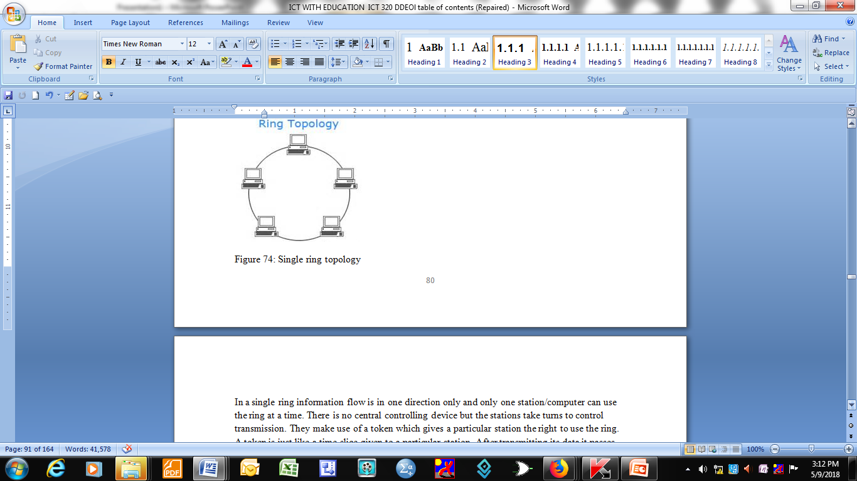
Ring network

Slide 25
In a single ring information flow is in one direction only and only one station/computer can use the ring at a time.
There is no central controlling device but the stations take turns to control transmission.
They make use of a token which gives a particular station the right to use the ring. A token is just like a time slice given to a particular station. After transmitting its data it passes the token to the next station.

Slide 26
A ring network may be disrupted by failure of a single link.
A node failure or cable break might isolate every node attached to the ring.
A ring network can be implemented using SONET (Synchronous Optical Network) or FDDI( Fibre distributed Data Interface).

Slide 27
SONET technology
This technology uses rings known as ‘self-healing rings.
It uses two or more transmission paths between network nodes. If there is a break in one line the other line may still be available.
For best security against failure a four-fibre bi=-directional ring is used.
The SONET ring uses digital cross-connects (DCs) or add/drop multiplexers (ADMs).

Slide 28
SONET ring variation
The ring can be:
Uni-directional (two)
Bi-directional (two)
Bi-directional (four)

Slide 29
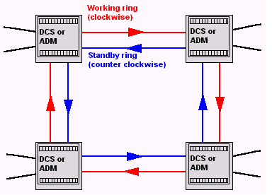
Two fibre uni-directional SONET token ring network

Slide 30
Operation
The two rings are not used simultaneously. The standby ring is for backup purposes.
For example if the working ring breaks, the standby ring ‘wraps’ the connection back around the working ring.

Slide 31
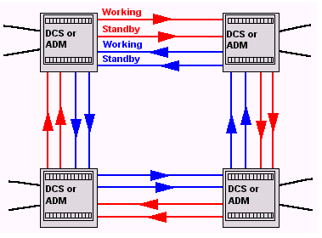
Bi-directional (four) SONET ring network

Slide 32
Fiber Distributed Data Interface (FDDI)
FDDI network contains two token rings, one for possible backup in case the primary ring fails.
The primary ring can transfer up to 100 Mbps capacity. If the secondary ring is not needed for backup, it can also carry data, extending capacity to 200 Mbps.
The single ring can extend the maximum distance; a dual ring can extend 100 km (62 miles).

Slide 33
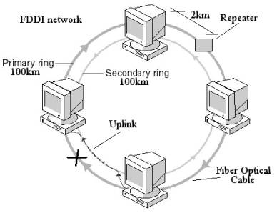
FDDI token ring network

Slide 34
Advantages
Orderly, every device has access to the token and the opportunity to transmit
Performs better than star topology under heavy network load
Can create much larger network using token ring
Does not require network server to manage the connectivity between computers
Prevents data collision because of the media access method
Additional nodes to the network have little impact on bandwidth

Slide 35
Disadvantages
One malfunctioning workstation or bad port in the multi-access unit(MAU) can create problems for the entire network
Data packets must pass through every computer between the sender and the recipient, this makes it slower
Moving, adding and changing of devices can affect the network
Network adapter cards and MAU are much more expensive than Ethernet cards and hubs
Much slower than Ethernet under normal load
All network interface cards must operate at the same speed
It is difficult to trouble shoot a ring network

